Slide 1
Analyzing Rutgers Research Topics and Finding Potential Correlation Based on
Google Scholar Profile Records
Group 50:
Junyan Dai
Feiyu Zheng

Slide 2
Analyzing Rutgers Google Scholar
Our Goal
Data Collection
Contents
Data Exploration
Modelling Data

Slide 3













Common Problems
Machine Learning
Chemistry
Economy
If students want to start their research journey, they probably may meet some the following problems:
They may not know which research areas could be connected.
They may not know which professors are in those research areas and could help them start their research journey.
Statistics
Robotics
Data Mining

Slide 4
Our Goal
We want to find which areas are often related together so that it can give students a common sense about possibly intersected areas.
Also, if students are interested about several research areas, we may also want to find out which professors at Rutgers are working on these areas so that students could know who they could contact to start their research.

Slide 5
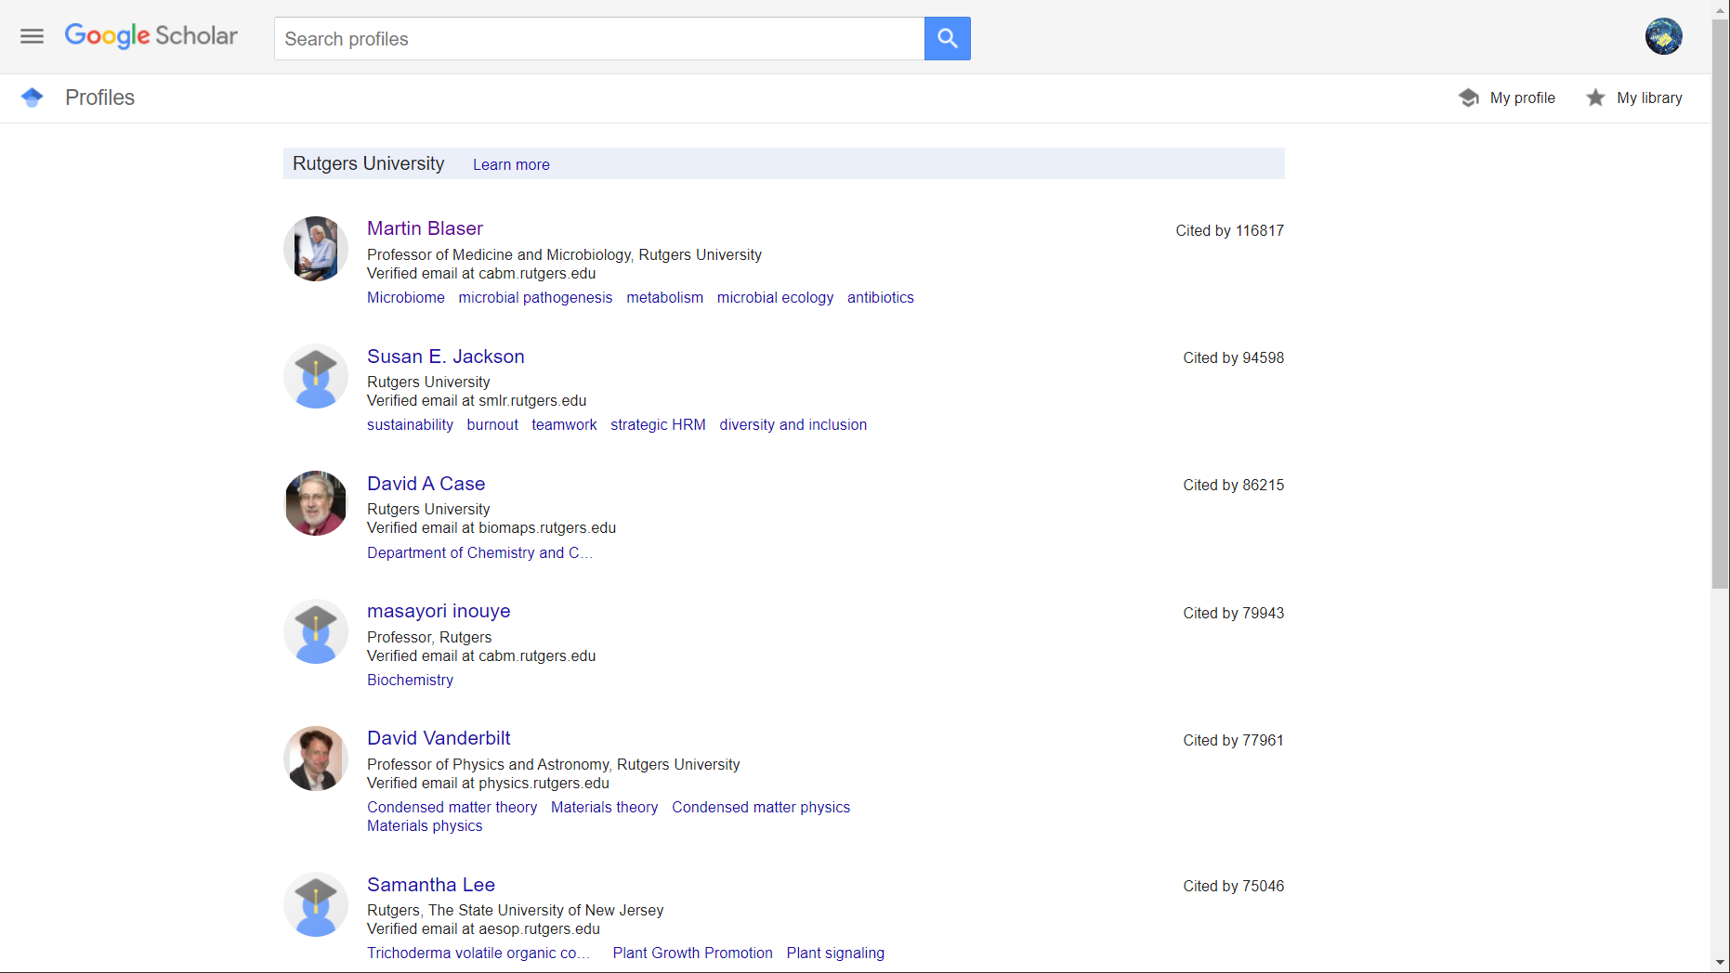
Data Collection Overview
Name
Web crawler
Data
Research areas
Database

Slide 6
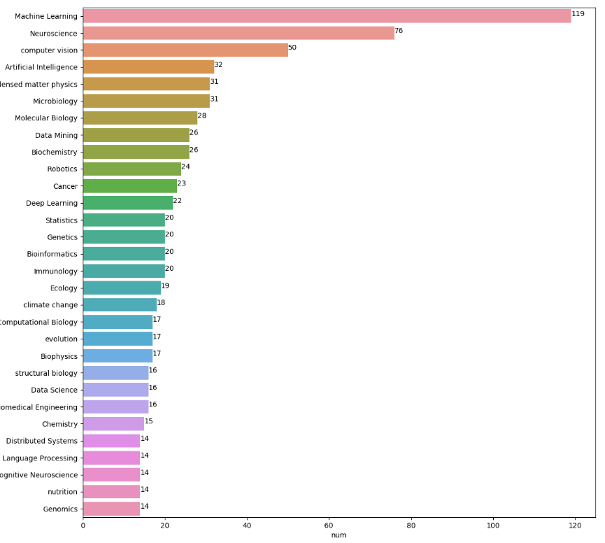
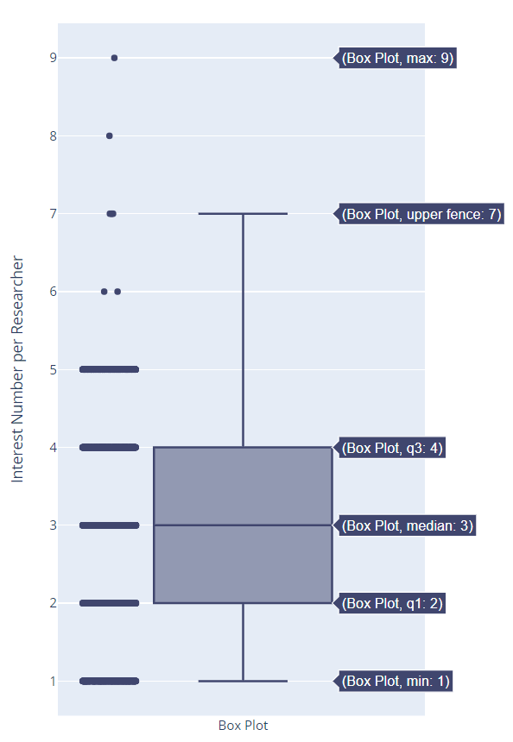
Data Exploration
Boxplot
Top 30 Interests among 2908 Researchers:
Valid different interests ＝ 4597
Valid total interests = 7919
Valid Researchers ＝ 2567
Average Interest/Researcher ≈ 3.08
Standard Deviation ≈ 1.4783
Maximum = 9
Minimum = 1
Summary:
Most researchers have more than 1 interests (commonly 2-4).
Only a small amount of interests are popular among researchers.

Slide 7
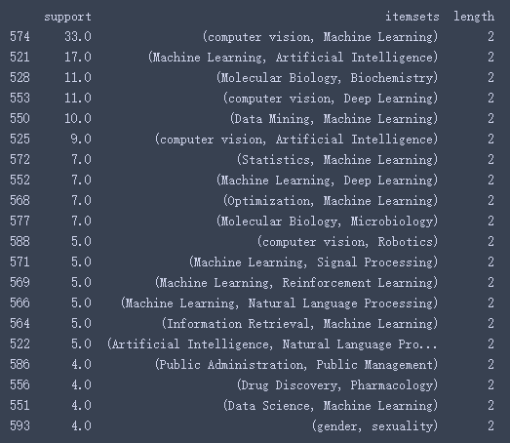
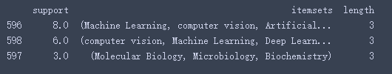
Data Exploration
Top 20 Frequently related Interests (Apriori Algorithm, minSup=3):
Length = 3
Length = 2

Slide 8
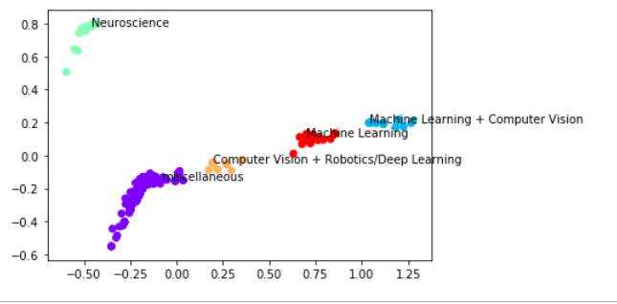
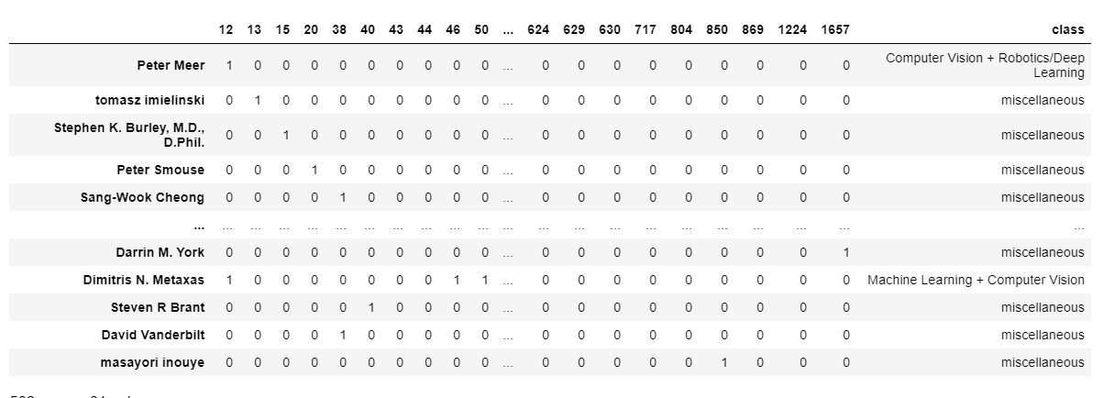
Modeling Data
5 Classes
Unsupervised Machine Learning Method
Connected Interest
Input Interest
Recommended Researcher
Prediction Model
Supervised Machine Learning Method
(80% training, 20% test)
Add classified label to each data

Slide 9
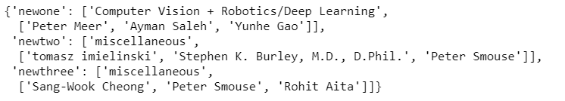
Modeling Data
newone (computer vision)
Prediction Model
Computer Vision + Robotics/Deep Learning
Researcher that may help:
Peter Meer
Ayman Saleh
Yunhe Gao
newtwo (data mining + computational biology)
Prediction Model
miscellaneous
Researcher that may help:
Tomasz imielinski
Stephen K…
Peter Smouse

Slide 10
Acknowledgment
Crawler Tool: Scrapy
Third party packages: pandas, sklearn.decomposition, sklearn.cluster.AgglomerativeClustering, matplotlib, d3.js, pymysql, json, plotly, scipy, numpy, mlxtend, seaborn
All Used Data Comes From Google Scholar
References:
[1] Apriori Algorithm Code: http://rasbt.github.io/mlxtend/user_guide/frequent_patterns/apriori/
[2] Boxplot Code: https://plotly.com/python/v3/basic-statistics/
[3] Unsupervised Machine Learning (Cluster) Code:
https://stackabuse.com/hierarchical-clustering-with-python-and-scikit-learn/
[4] Supervised Machine Learning (KNN) Code:
https://stackabuse.com/k-nearest-neighbors-algorithm-in-python-and-scikit-learn/
[5] Relation Graph Among Researchers:
https://d3js.org/
Thanks For Watching!
Group 50:
Junyan Dai
Feiyu Zheng

